Slide 1



NEXT.JS
FOSS PROJECT DEMO
FS’tival-22 — Review 0
Presented by:
TEAM ENCODERS
Daniel Inigo M (20C016)
Siva Guhan S (20C083)
Udaya Priya K (20C097)

Slide 2


About Tool
Next.js - minimalist framework for server rendered React applications
Open source tool
Developed by Vercel and the open source community

Slide 3




License
MIT License
Permissions
Commercial use
Modification
Distribution
Private use
Limitations
Liability
Warranty
Conditions
License and copyright notice

Slide 4
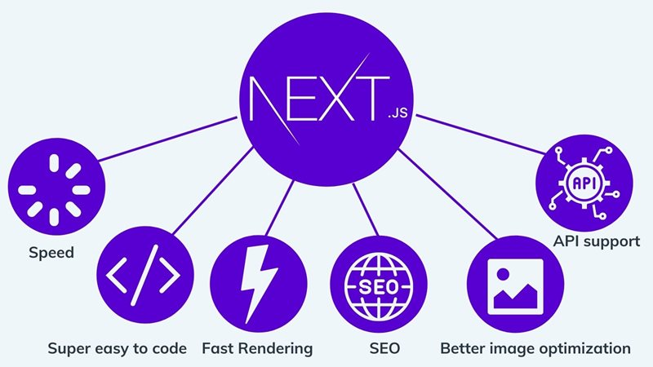
Advantages of Next.js
Excellent performance in terms of load times
Load times helped with “lazy loading” and automatic code splitting
Tons of support for developers
Fantastic user-experience
Faster time to market
Great Search Engine Optimization

Slide 5








Alternatives for Next.js
Gatsby
Hexo
Loopback
Angular Universal
React Router
Hugo

Slide 6
Problem Statement
To develop a web portal where people can get to know breaking news of the country.
Title, a short summary and a picture relevant to a particular breaking news story will be displayed to the user.
When the user clicks on the title of the news, it redirects to the news article.

Slide 7
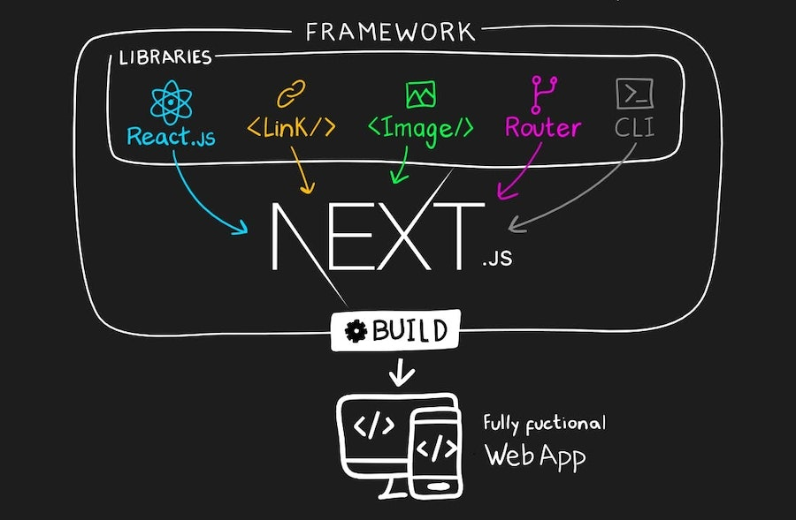
Thank You

